Slide 1
SQL
LECTURE 13
Relational databases and various methods to query them
Sean Kang

Slide 2
Databases

Slide 3
Brief Databases Overview
A database is an organized collection of data.
A database management system (DBMS) is a software system that stores, manages, and facilitates access to one or more databases.
Why use DBMSes?
Our data might not be stored in a simple-to-read format such as a CSV (comma-separated values) file.
Think of a CSV like an Excel sheet or a sheet in Google sheets.
So far, most of the data were given to you in CSV files, but that will not always be the case in the real world.
If our data are stored in a DBMS, we must use languages such as Structured Query Language (SQL) to query for our data.

Slide 4
Advantages of DBMS over CSV (or similar)
Data Storage:
Reliable storage to survive system crashes and disk failures.
Optimize to compute on data that does not fit in memory.
Special data structures to improve performance.
Data Management:
Configure how data is logically organized and who has access.
Can enforce guarantees on the data (e.g. non-negative bank account balance).
Can be used to prevent data anomalies.
Ensures safe concurrent operations on data.

Slide 5
Database Schemas

Slide 6
Relational DBMS Terminology
In a relational database, each table is called a relation.
Each row of relation is called a record or tuple. Rows do not have names.
Each column of a relation is called an attribute or field.
Attributes have names (e.g. temperature, city, legs).
Attributes have data types (e.g. INTEGER, CHAR(20)).
Attributes may also have integrity constraints (e.g. must be non-negative).
Attributes may be marked as primary or foreign keys.
Primary key must be unique. Example on next slide.
Foreign key means that an attribute is some other table’s primary key.
Explicitly shows how tables are linked.
Set of facts about the attributes is known as the “schema”.

Slide 7
Example Relation Schema
CREATE TABLE animal(
name TEXT,
legs INTEGER CHECK (legs >= 0)
weight INTEGER CHECK (weight >= 0),
PRIMARY KEY(name));
Name | Legs | Weight
Dog | 4 | 20
Cat | 4 | 10
Ferret | 4 | 10
T-Rex | 2 | 12000
Penguin | 2 | 10
Bird | 2 | 6
Given the table animal above, it is impossible to:
Insert a record with the same name as another.
Insert a record with a negative value for legs or weight.
Insert a record with a non-integer legs or weight.

Slide 8
Database Schema
A relational database is a set of relations.
Set of the schemas of those relations is called the database schema.
If the database schema includes foreign key relations, schema effectively includes a description how the tables refer to one another.

Slide 9
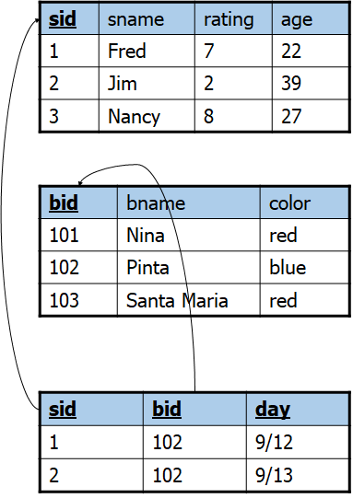
Example Database Schema
CREATE TABLE Sailors (
sid INTEGER,
sname CHAR(20),
rating INTEGER,
age REAL,
PRIMARY KEY (sid));
CREATE TABLE Boats (
bid INTEGER,
bname CHAR (20),
color CHAR(10),
PRIMARY KEY (bid));
CREATE TABLE Reserves (
sid INTEGER,
bid INTEGER,
day DATE,
PRIMARY KEY (sid, bid, day),
FOREIGN KEY (sid) REFERENCES Sailors,
FOREIGN KEY (bid) REFERENCES Boats);
Note: Primary key is all 3 attributes!

Slide 10
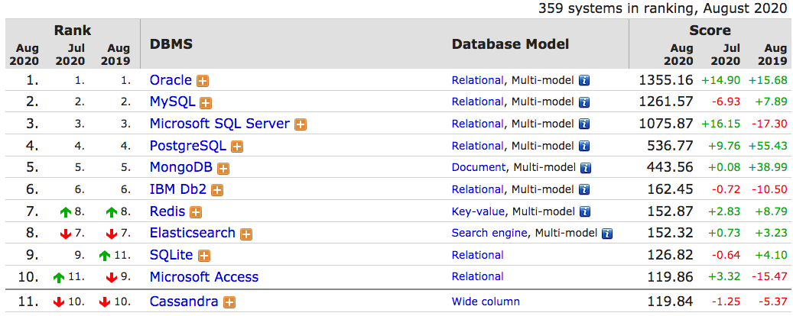
Database Implementations
We can query relational databases with SQL, but there are many implementations of SQL.
And many other database implementations that are not SQL based / relational.
The 4 most popular SQL RDBMS implementations.
Lightweight SQL implementation that we’ll use. Missing many features.
https://db-engines.com/en/ranking
Notes:
https://db-engines.com/en/ranking

Slide 11
SQL Overview

Slide 12
SQL Query Syntax
SELECT [DISTINCT] <column expression list>
FROM <list of tables>
[WHERE <predicate>]
[GROUP BY <column list>]
[HAVING <predicate>]
[ORDER BY <column list>]
[LIMIT <number of rows>];

Slide 13
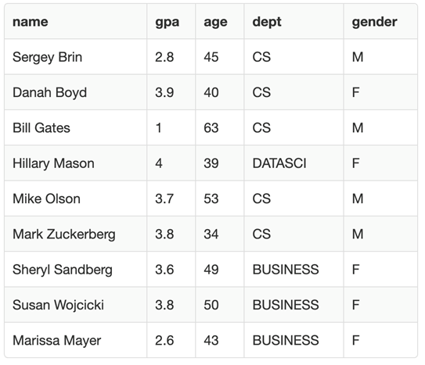
DISTINCT
students
SELECT DISTINCT dept from students;
SELECT COUNT(DISTINCT dept) from students;

Slide 14
DISTINCT
students
SELECT DISTINCT dept from students;
[Output: DATASCI, CS, BUSINESS]
SELECT COUNT(DISTINCT dept) from students;
[Output: 3]

Slide 15
Types of Joins

Slide 16
Cross Join - Querying Multiple Relations
All pairs of rows appear in the result.
s
id
name
t
0
Apricot
id
breed
1
Boots
1
persian
2
Cally
2
ragdoll
4
Eugene
4
bengal
5
persian
SELECT * FROM s, t;

Slide 17
Cross Join - Querying Multiple Relations
(... continued)
s.id
name
t.id
breed
All pairs of rows appear in the result.
s.id
name
t.id
breed
0
Apricot
4
bengal
s
id
name
0
Apricot
1
persian
1
Boots
4
bengal
t
1
Boots
1
persian
2
Cally
4
bengal
0
Apricot
id
breed
2
Cally
1
persian
4
Eugene
4
bengal
1
Boots
1
persian
4
Eugene
1
persian
0
Apricot
5
persian
2
Cally
2
ragdoll
0
Apricot
2
ragdoll
1
Boots
5
persian
4
Eugene
4
bengal
1
Boots
2
ragdoll
2
Cally
5
persian
5
persian
2
Cally
2
ragdoll
4
Eugene
5
persian
4
Eugene
2
ragdoll
SELECT * FROM s, t;
(to be continued …)

Slide 18
Inner Join
s
id
name
t
0
Apricot
id
breed
1
Boots
1
persian
2
Cally
2
ragdoll
4
Eugene
4
bengal
Only pairs of matching rows appear in the result.
5
persian
SELECT * FROM s JOIN t ON s.id = t.id;
SELECT * FROM s INNER JOIN t ON s.id = t.id;
SELECT * FROM s, t WHERE s.id = t.id;

Slide 19
Inner Join
s
id
name
s.id
name
t.id
breed
t
0
Apricot
id
breed
1
Boots
1
persian
1
Boots
1
persian
2
Cally
2
ragdoll
4
Eugene
4
bengal
2
Cally
2
ragdoll
4
Eugene
4
bengal
Only pairs of matching rows appear in the result.
5
persian
SELECT * FROM s JOIN t ON s.id = t.id;
SELECT * FROM s INNER JOIN t ON s.id = t.id;
SELECT * FROM s, t WHERE s.id = t.id;

Slide 20
Relationship Between Cross Joins and Inner Joins
s
s.id
name
t.id
breed
(... continued)
id
name
0
Apricot
1
persian
s.id
name
t.id
breed
t
0
Apricot
id
breed
1
Boots
1
persian
0
Apricot
4
bengal
2
Cally
1
persian
1
Boots
4
bengal
1
Boots
1
persian
4
Eugene
1
persian
2
Cally
4
bengal
2
Cally
2
ragdoll
0
Apricot
2
ragdoll
4
Eugene
4
bengal
4
Eugene
4
bengal
1
Boots
2
ragdoll
0
Apricot
5
persian
5
persian
2
Cally
2
ragdoll
1
Boots
5
persian
4
Eugene
2
ragdoll
2
Cally
5
persian
Conceptually, an inner join is a cross join followed by removal of bad rows.
(to be continued …)
4
Eugene
5
persian
SELECT * FROM s, t WHERE s.id = t.id;

Slide 21
Relationship Between Cross Joins and Inner Joins
s
id
name
s.id
name
t.id
breed
t
0
Apricot
id
breed
1
Boots
1
persian
1
Boots
1
persian
2
Cally
2
ragdoll
4
Eugene
4
bengal
2
Cally
2
ragdoll
4
Eugene
4
bengal
5
persian
Conceptually, an inner join is a cross join followed by removal of bad rows.
SELECT * FROM s, t WHERE s.id = t.id;

Slide 22
Left Outer Join
s
id
name
t
0
Apricot
id
breed
1
Boots
1
persian
2
Cally
2
ragdoll
4
Eugene
4
bengal
5
persian
SELECT * FROM s LEFT JOIN t ON s.id = t.id;
Every row in the first table appears in the result, matching or not.

Slide 23
Left Outer Join
s
id
name
s.id
name
t.id
breed
t
0
Apricot
id
breed
0
Apricot
1
Boots
1
persian
1
Boots
1
persian
2
Cally
2
ragdoll
2
Cally
2
ragdoll
4
Eugene
4
bengal
4
Eugene
4
bengal
Missing values are null.
5
persian
SELECT * FROM s LEFT JOIN t ON s.id = t.id;
Every row in the first table appears in the result, matching or not.

Slide 24
Right Outer Join
s
id
name
s.id
name
t.id
breed
t
0
Apricot
id
breed
1
Boots
1
persian
1
Boots
1
persian
2
Cally
2
ragdoll
2
Cally
2
ragdoll
4
Eugene
4
bengal
4
Eugene
4
bengal
5
persian
5
persian
Note: SQLite does not
implement RIGHT JOIN.
SELECT * FROM s RIGHT JOIN t ON s.id = t.id;
Every row in the second table appears in the result, matching or not.

Slide 25
Full Outer Join
s
id
name
s.id
name
t.id
breed
t
0
Apricot
id
breed
0
Apricot
1
Boots
1
persian
1
Boots
1
persian
2
Cally
2
ragdoll
2
Cally
2
ragdoll
4
Eugene
4
bengal
4
Eugene
4
bengal
5
persian
5
persian
Note: SQLite does not support FULL OUTER JOIN.
SELECT * FROM s FULL OUTER JOIN t ON s.id = t.id;
Every row in both tables appears, matching or not.

Slide 26
Other Join Conditions
student
teacher
age
name
age
name
29
James
52
Ian
37
Jin
41
Hellen
20
John
27
John
20
Emma
36
Anne
We can join on conditions other than equality.
SELECT * FROM student, teacher WHERE student.age > teacher.age;

Slide 27
Other Join Conditions
student
teacher
age
name
age
name
29
James
52
Ian
29
James
27
John
37
Jin
41
Hell
37
Jin
27
John
20
John
27
John
37
Jin
36
Anne
20
Emma
36
Anne
We can join on conditions other than equality. Note that every satisfying pair appears.
Inner joins are just cross joins followed by removing rows that don’t match.
SELECT * FROM student, teacher WHERE student.age > teacher.age;

Slide 28

https://www.codeproject.com/KB/database/Visual_SQL_Joins/Visual_SQL_JOINS_orig.jpg

Slide 29
NULL Values

Slide 30
Brief Detour: NULL Values
Field values are sometimes unknown
SQL provides a special value NULL for such situations
Every data type can be NULL
The presence of null complicates many issues. E.g.:
Selection predicates (WHERE)
Aggregation
But NULLs are common after outer joins

Slide 31
Explicit NULL Checks
To check if a value is NULL you must use explicit NULL checks
SELECT * FROM student WHERE name IS NULL;
SELECT * FROM student WHERE name IS NOT NULL;

Slide 32
Aggregation with NULLs
s.id
name
t.id
breed
0
Apricot
1
Boots
1
persian
Aggregates ignore NULL-valued inputs.
2
Cally
2
ragdoll
4
Eugene
4
bengal
SELECT COUNT(t.id) FROM s LEFT JOIN t ON s.id = t.id;
SELECT SUM(t.id) FROM s LEFT JOIN t ON s.id = t.id;
SELECT AVG(t.id) FROM s LEFT JOIN t ON s.id = t.id;
SELECT COUNT(*) FROM s LEFT JOIN t ON s.id = t.id;
Notes:
https://learnsql.com/blog/null-comparison-operators/

Slide 33
Aggregation with NULLs
s.id
name
t.id
breed
0
Apricot
1
Boots
1
persian
Aggregates ignore NULL-valued inputs.
2
Cally
2
ragdoll
4
Eugene
4
bengal
SELECT COUNT(t.id) FROM s LEFT JOIN t ON s.id = t.id; [Output: 3]
SELECT SUM(t.id) FROM s LEFT JOIN t ON s.id = t.id; [Output: 7]
SELECT AVG(t.id) FROM s LEFT JOIN t ON s.id = t.id; [Output: 7/3]
SELECT COUNT(*) FROM s LEFT JOIN t ON s.id = t.id; [Output: 4]

Slide 34
SQL Predicates and Casting

Slide 35
SQL Predicates
In addition to numerical comparisons (=, <, >), SQL has built-in predicates.
Example: The IN operator tests whether a value is in a list.
E.g., select rows whose month is either January, March, or May:
SELECT * FROM t WHERE t.month IN ('January', 'March', 'May')
Example: The LIKE operator tests whether a string matches a pattern (similar to a regex, but much simpler syntax):
E.g. select rows where the time string is on the hour, such as 8:00 or 12:00 pm.
SELECT * FROM t WHERE t.time LIKE ‘%:00%’;

Slide 36
SQL Casting
Can use CAST to convert fields from one type to another:
Handy when combined with WHERE:
SELECT primaryTitle AS title,
CAST(runtimeMinutes as int) AS time
FROM titles
WHERE time > 500
LIMIT 10;

Slide 38
SQL Sampling, Subqueries, and Common Table Expressions

Slide 39
Sampling with LIMIT?
students
SELECT * FROM students LIMIT 5;
SELECT * FROM students ORDER BY name LIMIT 5;

Slide 40
Sampling with LIMIT?
students
SELECT * FROM students LIMIT 5;
Convenience sample?
SELECT * FROM students ORDER BY name LIMIT 5;
Probability sample
Not a Simple Random Sample

Slide 41
Random Sampling
The random sampling methods available depend on the database engine. Suppose we want to draw a SRS from an SQL table.
One common approach (with SQLite):
SELECT * FROM action_movie ORDER BY RANDOM() LIMIT 3
May seem inefficient to order the entire table by some random values, then to only select 3.
Query optimization under the hood will make this much more efficient.
Reminder: SQL is a declarative language. You say “what”, not “how”.

Slide 42
Random Sampling
Suppose we want to pick 3 random years.
SELECT year FROM action_movie
GROUP BY year
ORDER BY RANDOM()
LIMIT 3

Slide 43
Random Sampling
Suppose we want to get all movies from 3 randomly selected years.
SELECT * FROM action_movie
WHERE year IN (
SELECT year FROM action_movie
GROUP BY year
ORDER BY RANDOM()
LIMIT 3
)
Note: This is sometimes known as a “cluster sample.”
Effectively creates a temporary unnamed table that contains 3 randomly selected years.

Slide 44
Random Sampling
Suppose we want to get all movies from 3 randomly selected years.
SELECT * FROM action_movie
WHERE year IN (
SELECT year FROM action_movie
GROUP BY year
ORDER BY RANDOM()
LIMIT 3
)
Note: This is sometimes known as a “cluster sample.”
Effectively creates a temporary unnamed table that contains 3 randomly selected years.
Known as a “subquery”.

Slide 45
Subqueries
A query within another query can be used to create a temporary table.
In a FROM clause: Describe a table instead of naming it.
E.g., join table u with a simple random sample from table t:
SELECT * FROM (SELECT * FROM t ORDER BY RANDOM() LIMIT 10), u;
In a WHERE clause: Describe a one-column table instead of a list; used with IN.
E.g., select rows in a top-3 most popular month:
SELECT * FROM t WHERE t.month IN (SELECT month FROM months ORDER BY popularity DESC LIMIT 3);

Slide 46
Common Table Expressions
A Common Table Expressions (CTE) allows for the creation of “temporary tables” to help organize complex queries.
CTEs can help make complex queries more readable.
CTEs can be used instead of subqueries.
WITH t2 AS (
SELECT * FROM t ORDER BY RANDOM() LIMIT 10
)
SELECT * FROM t2, u;

Slide 47
SQL CASE Expressions and SUBSTR

Slide 48
CASE Expressions
Without a base expression:
CASE WHEN born < 1980 THEN 'old'
WHEN born < 2000 THEN 'not too old'
ELSE 'young'
END
With a base expression:
CASE year % 10 WHEN 0 THEN 'start of decade'
WHEN 5 THEN 'middle of decade'
END
A CASE expression chooses among alternative values.
base expression

Slide 49
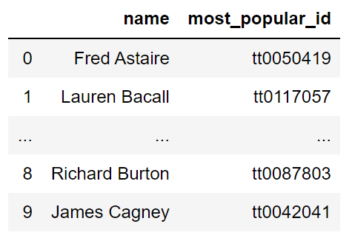
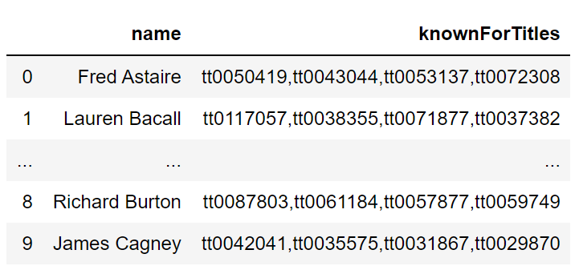
SUBSTR
SUBSTR allows you to extract substrings.
SELECT name, SUBSTR(knownForTitles, 1, INSTR(knownForTitles, ',')-1)
AS most_popular_id
FROM names

Slide 50
Conclusion

Slide 51
Summary
SQL is a programming language designed for data queries
SQL databases enable large-scale data processing
Databases are limited by disk size while Python is limited by memory size (disk size is usually much larger than memory size)
Sampling procedures can be directly implemented in SQL
Subqueries and common table expressions allow for the composition of complex queries

